Slide 1
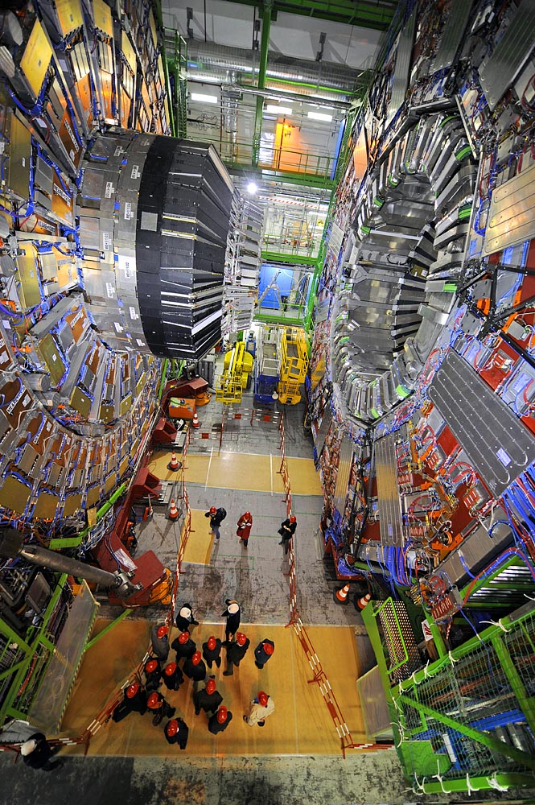
The Large Hadron Collider
and Particle Physics
Discovering the Higgs Boson and Looking Beyond
Souvik Das
Purdue University

Slide 2
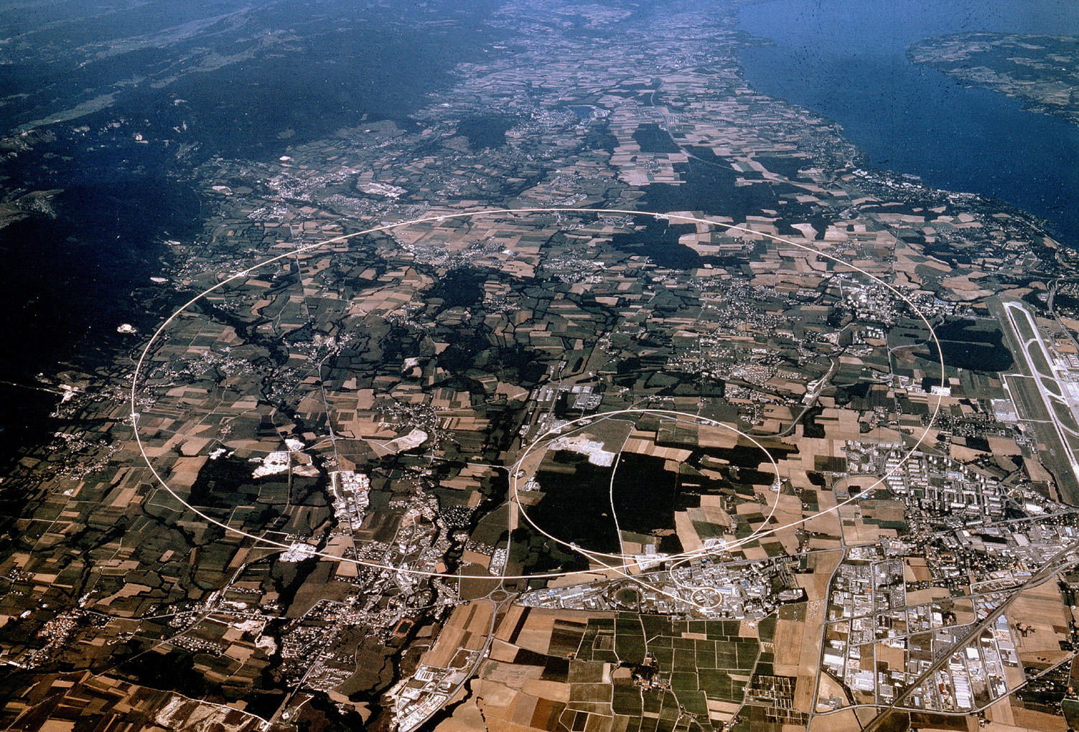
CERN – European Centre for Nuclear Research
In one of the world’s biggest laboratories, 100 m under the ground,
CMS Experiment
The Large Hadron Collider

Slide 3
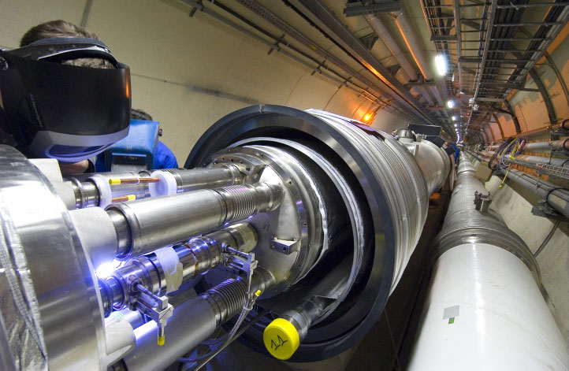
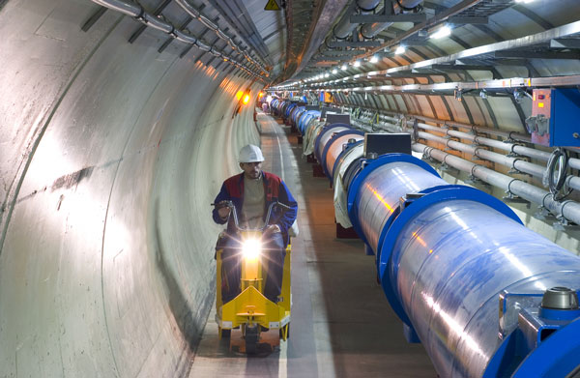
The Large Hadron Collider
in the emptiest place in our solar system, lies the world’s fastest racetrack,
The beam pipe is evacuated to the same vacuum as interplanetary space
The pressure is about 1/10th that of the surface of the moon.
Protons race around a 27 km circuit at 99.9999991% (6.5 TeV) the speed of light,
crashing into each other 40,000,000 times a second.

Slide 4
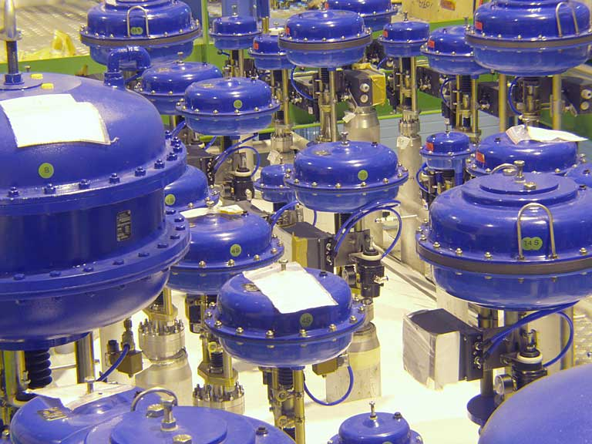
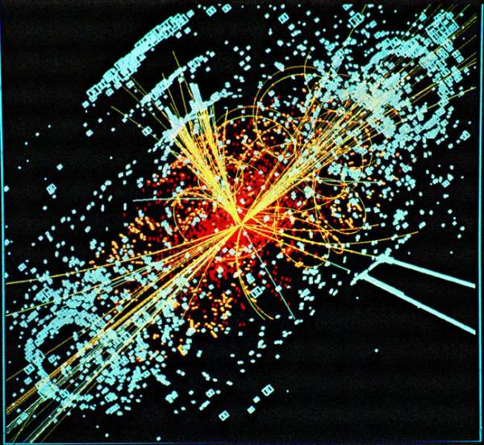
The Large Hadron Collider
in one of the coldest regions in the galaxy, occur some of the hottest reactions
Electromagnets for the experiment are maintained at -271.3 C or 1.9 K.
That is a little colder than interstellar space.
Violent collisions corresponding to temperatures a billion times higher than the core of the sun are produced. That is roughly 160,000,000,000,000,000 C

Slide 5
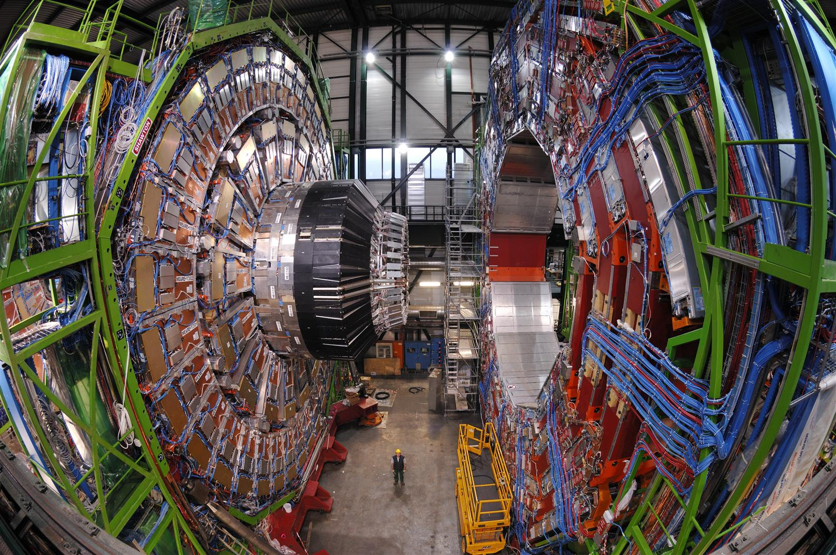

CERN – European Centre for Nuclear Research
Watched by the most complex “eyes” ever built, and analyzed by one of the most powerful computing systems in the world
The detectors have 140 million data channels observing at 40 million times a second.
The detectors spews out analyzed data at 700 MB/sec.
That is ~30,000 Encyclopedia Britannicas every second!

Slide 6

High Energy Physics
Why?
What is everything made of?
2. What holds it all together?

Slide 7
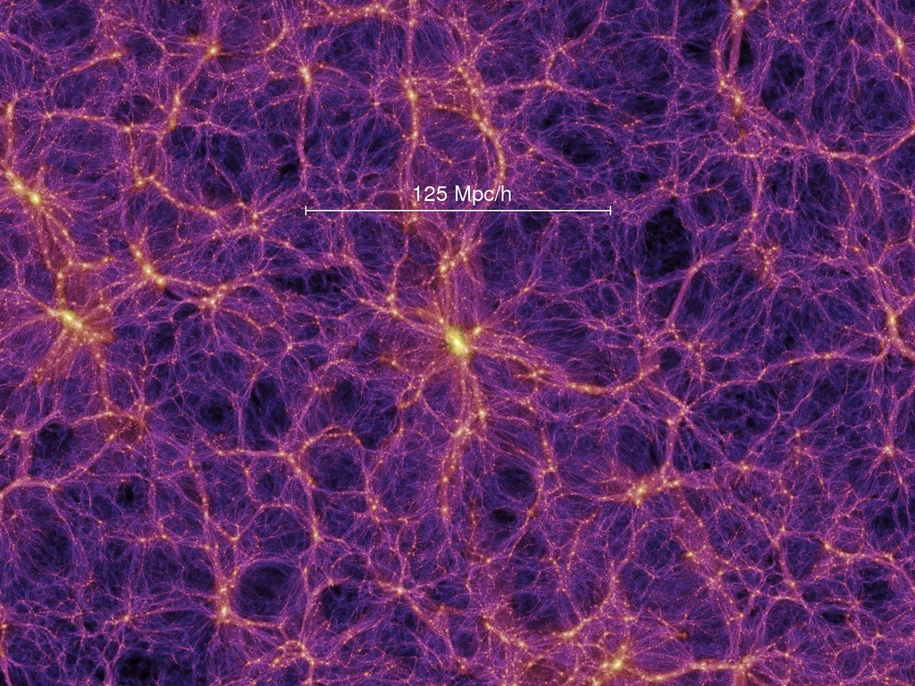
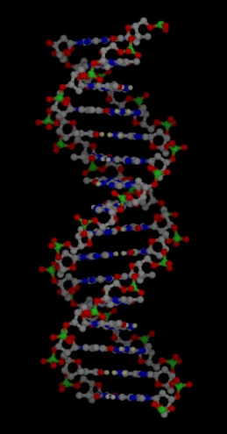

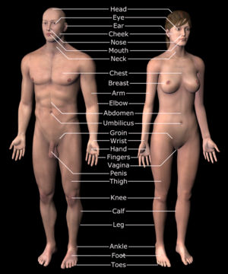
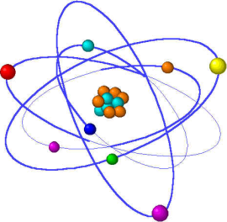
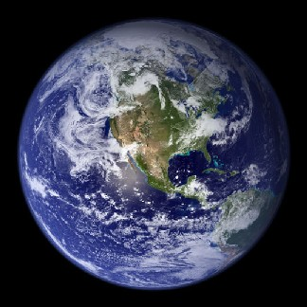
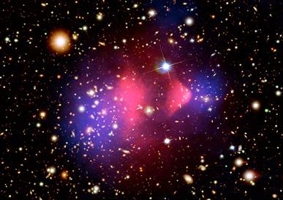
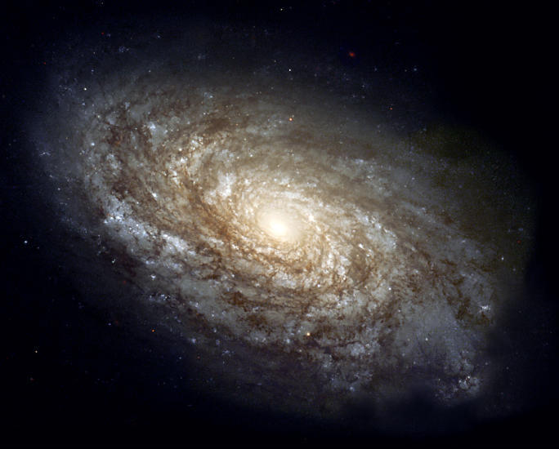
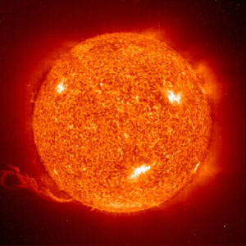
What is everything made of?
Colliding galaxies reveal dark matter

Slide 8
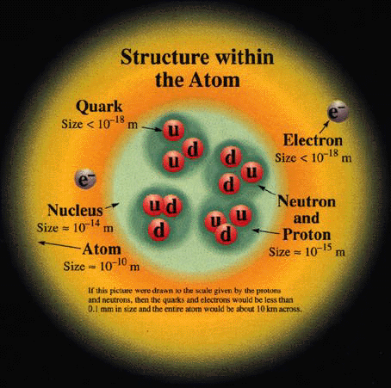
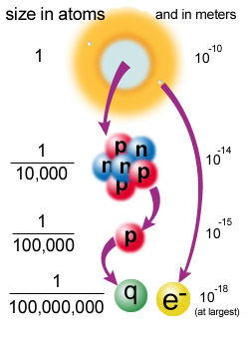
What is everything made of?
By convention there is colour,
By convention sweetness,
By convention bitterness,
But in reality there are atoms and space.
- Democritus (400 B.C.)

Slide 9











What is everything made of?
Why 3 generations? No one really knows!
Electron
0.5 MeV
Muon
106 MeV
Tau
1.8 GeV
1897
1936
1974
Leptons
Electron
Neutrino
Muon
Neutrino
Tau
Neutrino
1956
1962
2000
Up
~3 MeV
Charm
1.5 GeV
Top
173 GeV
1967
1974
1995
Quarks
Down
~5 MeV
Strange
100 MeV
Bottom
4.2 GeV
1967
1964
1977

Slide 10
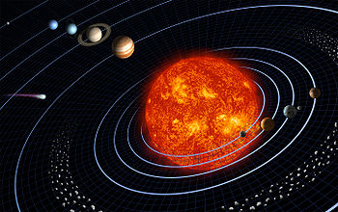
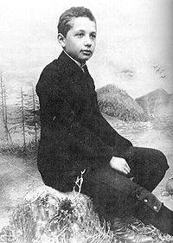
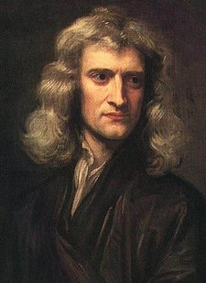
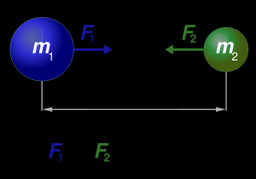
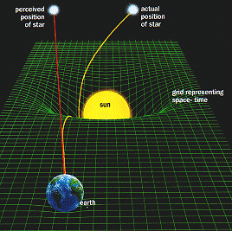
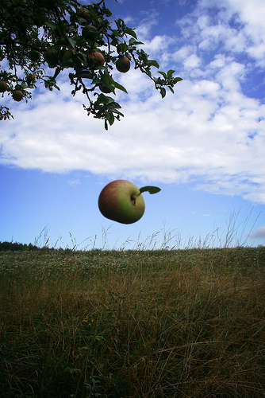
What holds everything together? – (I) Gravitation
Celestial Gravitation
Newton’s Law of
Universal
Gravitation
Einstein’s
General Theory of Relativity
Terrestrial Gravitation

Slide 11
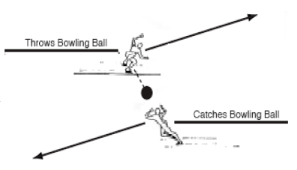
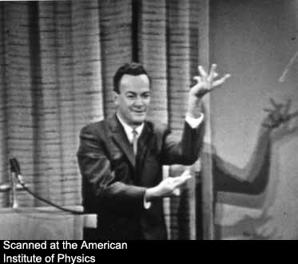
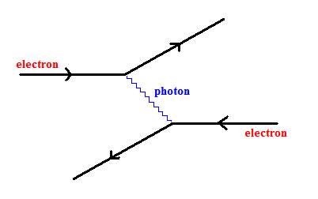
Forces as Interactions
All forces can be thought of as interactions between elementary particles.
All forces are mediated by a force-carrying particle.
Richard Feynman
A Feynman Diagram for two electrons repelling each other

Slide 12
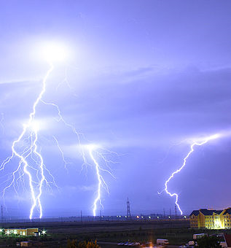
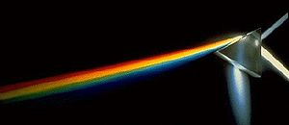
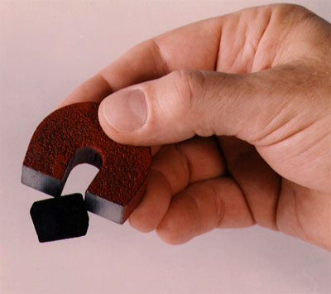
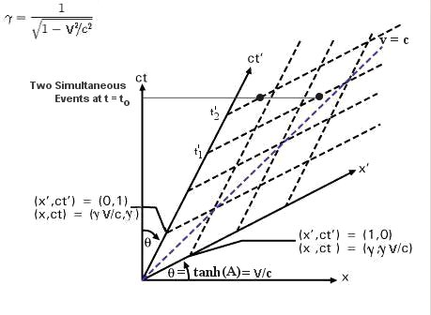
What holds everything together? – (II) Electromagnetism
Chemistry
The Electromagnetic Force
Felt by all charged particles
Carried by particles called photons in the quantum theory
Light
Electricity
Photon
0 mass
4 dimensional space-time
Magnetism

Slide 13
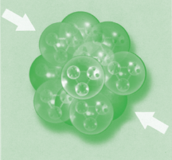
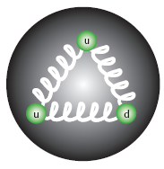
What holds everything together? – (III) Strong Nuclear Force
gluon
0 mass
Binds quarks together to form protons and neutrons
Binds protons and neutrons together to form atomic nuclei
The Strong Nuclear Force
Operational inside neutron stars and other exotic matter
Mediated by particles called gluons
Quarks and other gluons feel this force
Very short in range

Slide 14
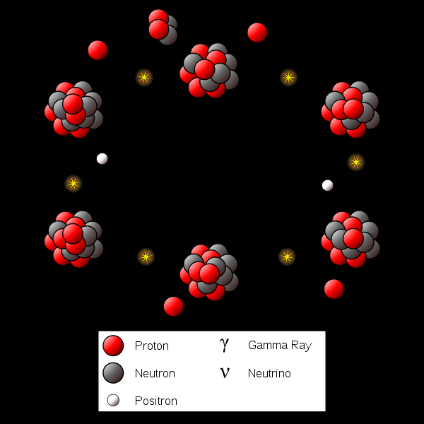
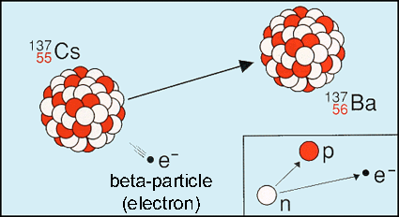
What holds everything together? – (IV) Weak Nuclear Force
Officiates nuclear (beta) decays
Give us nuclear cycles…
… that powers our sun and other stars.
The Weak Nuclear Force
All matter particles feel this force
Mediated by particles called W and Z bosons
Short ranged
W
80 GeV
Z
91 GeV

Slide 15

The Quest for Unification
Electricity
Electromagnetism
Magnetism
Photon
0 mass
Electroweak
Force
0 mass
Weak Nuclear Force
But this theory predicts a new undiscovered particle!
W
80 GeV
Z
91 GeV
Grand Unified Force
(Lots of hypotheses)
Higgs
125 GeV
Strong Nuclear Force
gluon
0 mass
Celestial Gravitation
General Theory of Relativity
No battletested quantum theory yet!
Universal Gravitation
Terrestrial Gravitation

Slide 16
The Standard Model of Particle Physics
Matter particles
Force particles
Electron
0.5 MeV
Muon
106 MeV
Tau
1.8 GeV
Photon (γ)
0 mass
Leptons
Electron
Neutrino
Muon
Neutrino
Tau
Neutrino
W
80 GeV
Z
91 GeV
Up
~3 MeV
Charm
1.5 GeV
Top
173 GeV
Quarks
gluon
0 mass
Down
~5 MeV
Strange
100 MeV
Bottom
4.2 GeV
Higgs
125 GeV

Slide 17
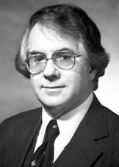
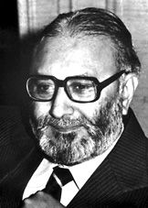


The Higgs Boson – Breaking Electroweak Symmetry
Higgs
125 GeV
The Glashow-Salam-Weinberg theory of Electroweak Unification:
Places the the γ, W and Z on the same footing as symmetrical cousins.
Accurately predicts the ratio of masses of the W and Z bosons in terms of the strengths of the electromagnetic and weak forces.
Requires a mechanism to break the symmetry to lend the W and Z mass
The Higgs mechanism is the simplest mechanism to break electroweak symmetry. (Same mechanism also explains superconductivity)
Predicts a new particle that is the Higgs boson.
The interaction strength between the Higgs and other fields are set theoretically but its mass is not. Its mass has to be determined experimentally

Slide 18

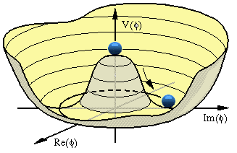
The Higgs Boson – Generating Mass
Mexican hat potential wells aid dynamic symmetry breaking
The Higgs field gives the W and Z mass through Electroweak Symmetry Breaking
But the mathematical structure of the Higgs also allows it to give mass to the matter fields, by interacting with them
One elegant solution to two problems!
The Higgs boson does not contribute any significant mass to protons or people

Slide 19
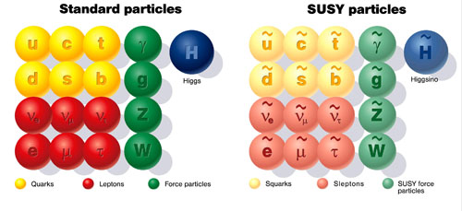
Outstanding Mysteries – Unification of the Forces
Grand Unification and Supersymmetry
Matter particles follow Fermi-Dirac statistics. Force carrier particles follow Bose-Einstein statistics. There is theoretical reason to believe that every matter particle has a “supersymmetric” twin with identical charge properties but following Bose-Einstein statistics. And every force carrier particle has a “supersymmetric” twin with identical force carrying properties but following Fermi-Dirac statistics. This is called the theory of Supersymmetry.
Supersymmetry offers a compelling way to unify the Electroweak and Strong forces.
Supersymmetry can also offer explanations of the Higgs mass.
Electroweak
Force
0 mass
gluon
0 mass
But does it exist?

Slide 20
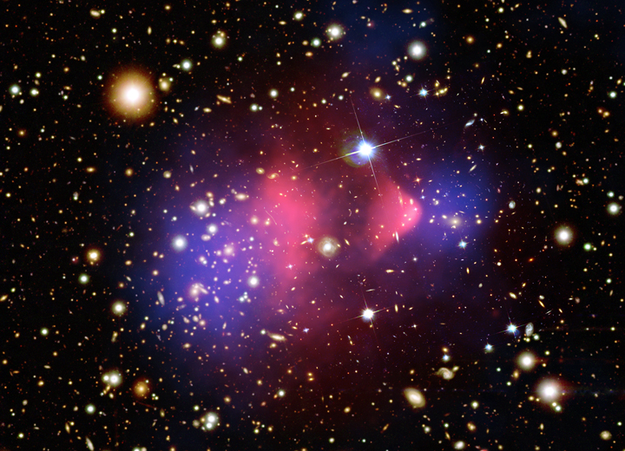
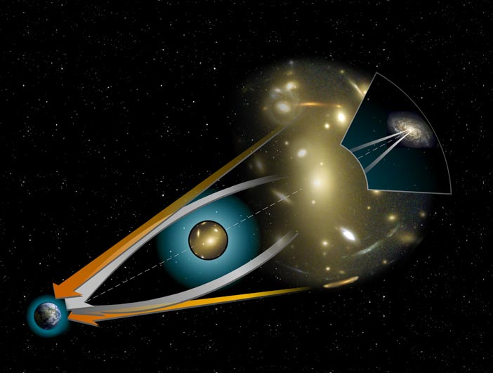
Outstanding Mysteries – Dark Matter
Gravitational lensing
The Bullet Cluster (1E 0657-56). Two galaxies colliding. Red shows concentration of visible matter. Blue shows dark matter inferred by gravitational lensing.
What is dark matter composed of?
Supersymmetric particles perhaps? The lightest supersymmetric particle predicted by theory has all the right properties!

Slide 21
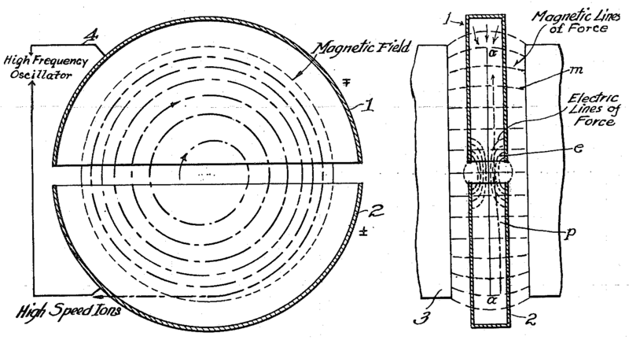
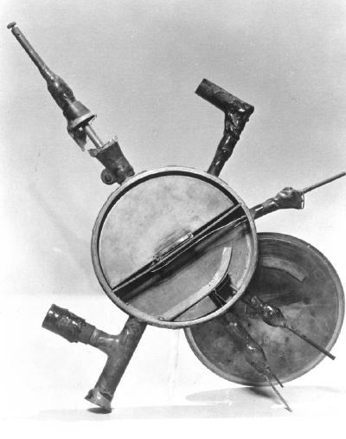
The Particle Accelerator
The patent to the first particle accelerator (cyclotron) developed by Ernest O. Lawrence in 1929
Ionize some atoms so they become charged
Speed them up using electrical fields
Curve them in a manageable track using magnetic fields
Once at sufficient speed, smash them into something!
Have particle detectors handy to “see” what comes out. New particles perhaps?
The first particle accelerator (cyclotron) developed by Ernest O. Lawrence in 1929

Slide 22
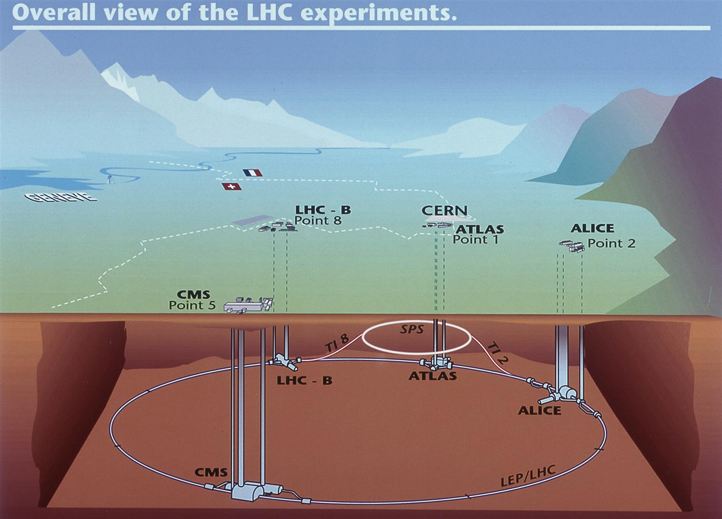
The Particle Accelerator
100 m below the surface
27 km in circumference

Slide 23
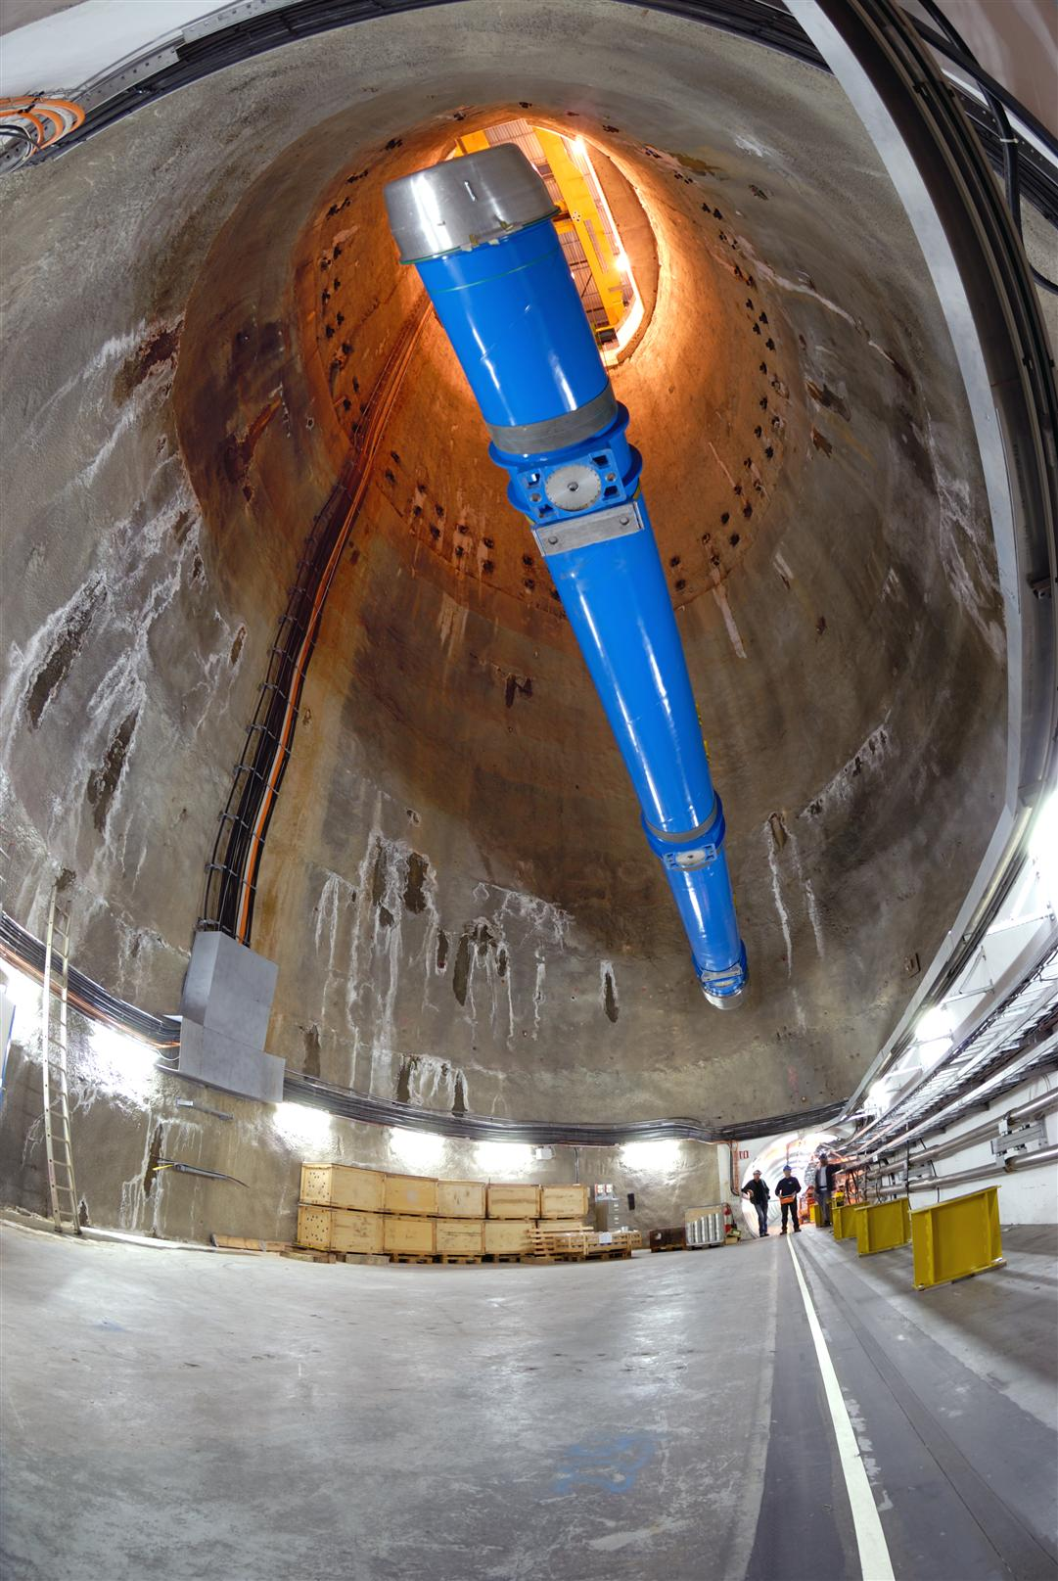
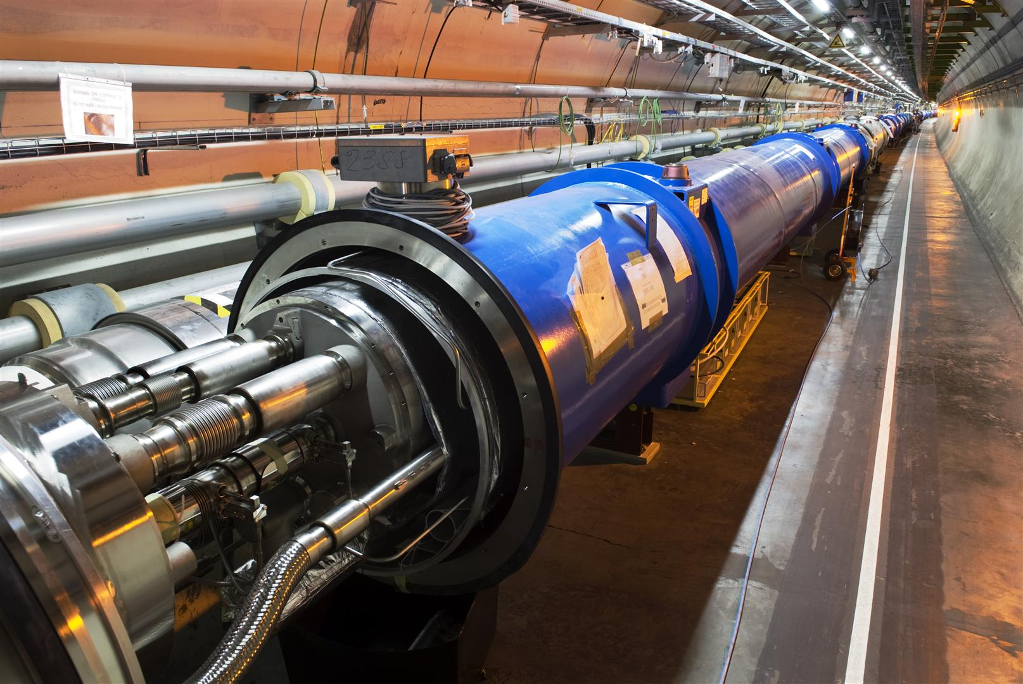
The Particle Accelerator
Giant dipole electromagnets (time-varying) are used to accelerate the protons. Each is 15 m long and weighs 35 tons.
20 km of superconducting dipole magnets using 96 tons of superfluid helium at 1.9 K
8.3 T magnetic field required to keep protons in circular track. Draws a current of 11,700 A. Average family house draws less than 70 A.

Slide 24
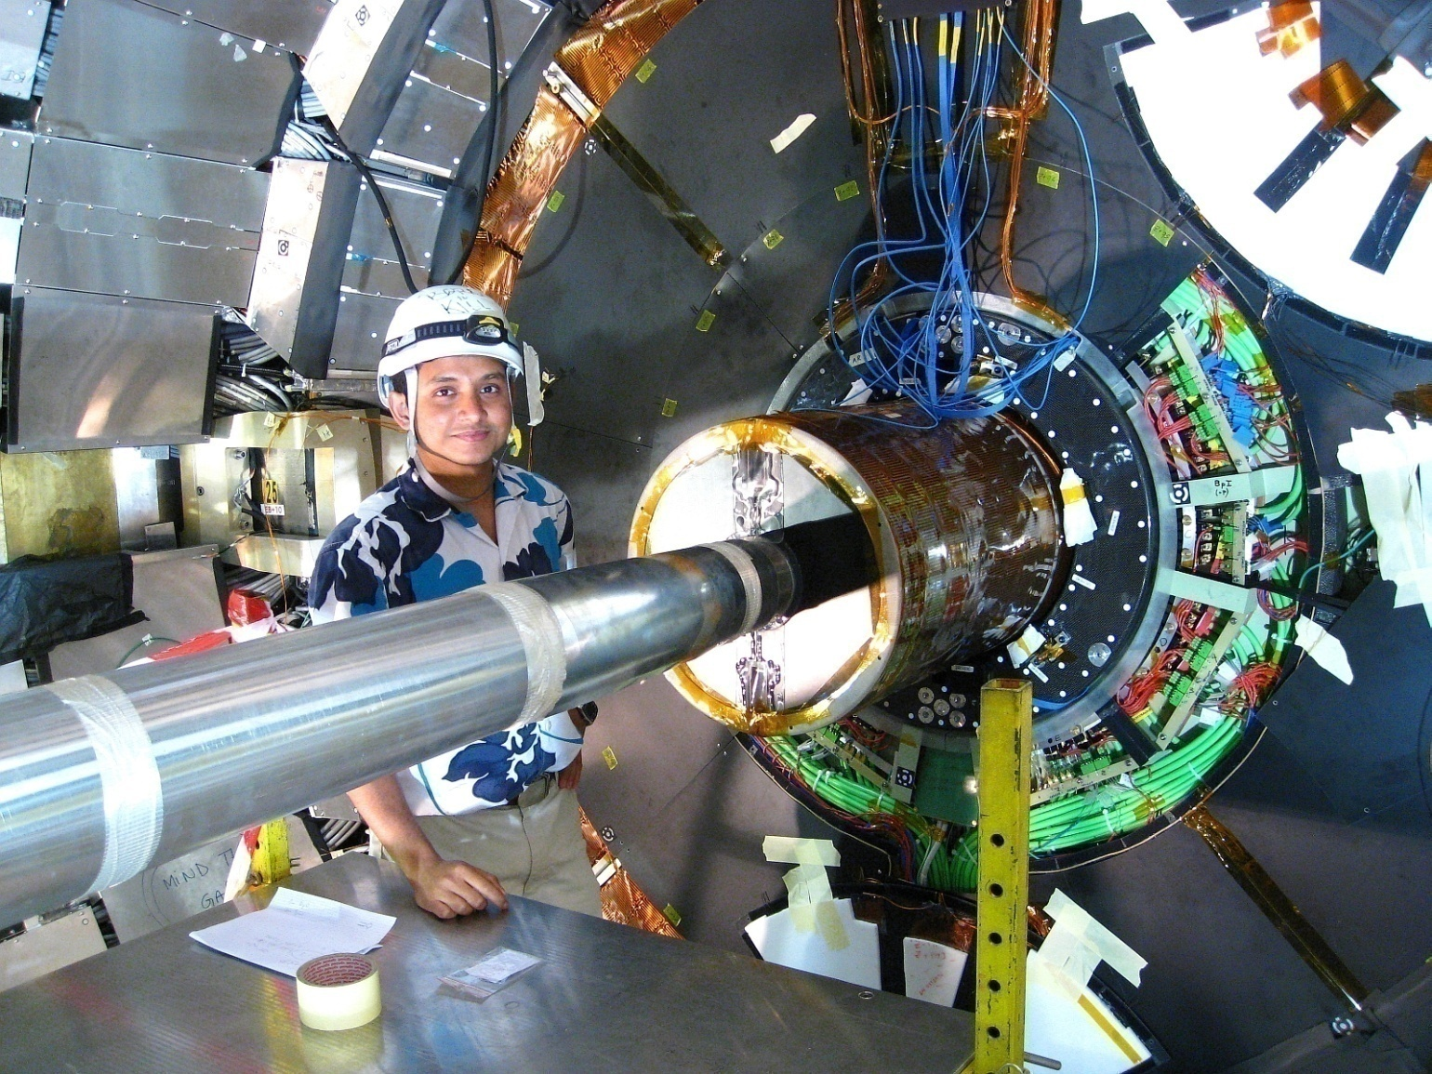
The Particle Accelerator
The pipe carrying the beam of protons is evacuated to 10⁻¹³ atmospheres of pressure to avoid protons colliding into stray atoms.
The counter rotating beams of protons, each carrying about the energy of a 400 ton train traveling at 150 km/h, are made to crash at the center of each experiment.
Near the collision point of the CMS experiment. 2007.

Slide 25
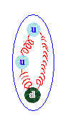
Collision Point
up quark
gluons
down quark
proton
Travelling at 99.9999991% the speed of light,
carrying 6500 GeV of energy each.
The energy allows them to overcome their mutual electromagnetic repulsion and allows their quarks and gluons to interact via the strong nuclear force.

Slide 26
The Crash – Approach
Quarks of different protons begin to feel each other through gluons because they are so close!

Slide 27
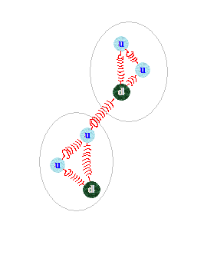
The Crash – Interaction
The newly formed gluon is under high tension now!
And so may be the other gluons since the whole protons received a tremendous shock.

Slide 28
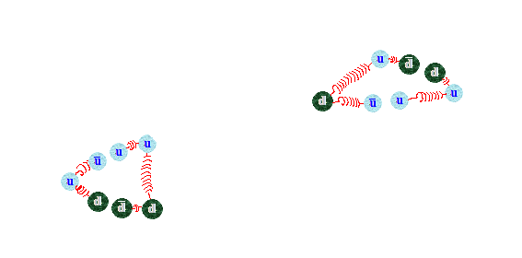
The Crash – Production of New Particles!
Top quarks are quite heavy and hence couple strongly to the Higgs boson.
Here they could “radiate” a real Higgs boson!
Higgs
t-t pair
The stretched gluon snaps into a top & antitop quark pair of virtual particles!
Gluons snap forming quark – antiquark pairs!
Protons fragment into sprays of newly formed hadronic debris. Don’t interest us usually.

Slide 29
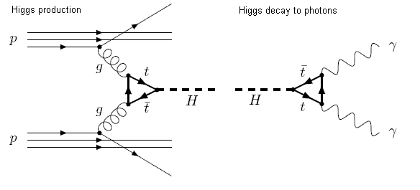
The Higgs Boson Decays into Two Photons
Photon
0 mass
t-t pair
Higgs
Photon
0 mass
Photons can be directly observed with our detectors.

Slide 30




ATLAS, CMS, ALICE and LHCb

Slide 31

CMS

Slide 32

CMS
Inserting the Tracker into the CMS experiment. 2008.

Slide 33

CMS
Notes:
Buttons. Click on any particle type to display the relevant slide with animations. Clicking again will return to this slide.
Recommend putting this slide in the middle of your presentation and putting the other 5 slides at the end.
If you have any difficulties, contact David.Barney@cern.ch

Slide 34



CMS
Notes:
Muon: passing through CMS, bending in the field (both ways, depending on when it is inside or outside of the solenoid) leaving hits in the Tracker layers and the muon chambers before escaping completely

Slide 35



CMS
Notes:
Electron: Bending in the magnetic field, leaving hits in the tracker layers and being “stopped” by the electromagnetic calorimeter

Slide 36



CMS
Notes:
Charged hadron: Bends in the magnetic field and leaves signals in the tracker layers; passes through the electromagnetic calorimeter leaving essentially no signal, and is “stopped” by the hadron calorimeter

Slide 37


CMS
Notes:
Neutral hadron: Does not bend in the magnetic field and does not leave any signal in the tracker layers; passes through the electromagnetic calorimeter leaving essentially no signal, and is “stopped” by the hadron calorimeter

Slide 38



CMS
Notes:
Photon: passes through the tracker without bending in the magnetic field or leaving hits, is “stopped” by the electromagnetic calorimeter

Slide 39
H → γγ – Invariant Mass
Higgs Boson Invariant Mass Histogram
Events / 5 GeV
m_{γγ} (GeV)
Recall E² = p²c² + m²c⁴ (Special Theory of Relativity)
This holds true for the energy and momentum of the Higgs boson.
The energy of the Higgs boson is the scalar sum of the energies of the 2 photons.
The momentum of the Higgs boson is the vector sum of the momenta of the 2 photons.
will peak at the mass, mc², of the Higgs boson.

Slide 40
H → γγ – Invariant Mass
Higgs Boson Invariant Mass Histogram
Events / 5 GeV
m_{γγ} (GeV)
But, this is not a perfect detector. So there will be tails. The width of this distribution is the detector resolution.

Slide 41
H → γγ – Invariant Mass
Higgs Boson Invariant Mass Histogram
Events / 5 GeV
m_{γγ} (GeV)
A cornucopia of processes also produce pairs of photons in proton-proton collisions. The invariant mass for these will not peak at the Higgs mass. These are background processes
We distinguish the peaking signal sitting on top of the background using statistical methods

Slide 42


H → γγ – Invariant Mass
The probability that the peak arises from statistical fluctuation is less than 1 in 3 million (5 sigma)

Slide 43


The Higgs Boson Decays into Muons
Muon
Z
Anti-Muon
Higgs
Muon
Z
Anti-Muon
Muons and anti-muons are long-lived particles that can be directly observed with our detectors.

Slide 44



Discovery of the Higgs Boson
“I think we got it”
Rolf Heuer,
4th of July, 2012
Several properties were tested over the next 6 years. The particle is entirely consistent with the Higgs boson

Slide 45
Precision Higgs Measurements
All four main Higgs Production Mechanisms have been observed
Gluon-gluon fusion
Weak boson fusion
Weak boson radiation
top quark radiation
Just reported in April 2018
Updated on Sept 27, 2018
Submitted to Eur. Phys. J.
Any deviation could be a clue to deeper physics!
Active area of research

Slide 46
Dark Matter and Supersymmetry Searches
Several (~ 15) searches for dark matter and supersymmetry searches underway
Mono-jet + Missing energy searches
A “mediator” particle Z’ is theoretically necessary that communicates between the Dark Sector and the Standard Model
Signature would be a jet of particles and missing energy
Some range of dark matter and Z’ masses have been excluded.
EXCLUDED
Higgs + Dark Matter searches
The Higgs boson could be produced in association with Dark Matter. We know how to “tag” Higgs bosons reliably.
Signature would be a Higgs boson and missing energy
Some range of dark matter and Z’ masses have been excluded.
EXCLUDED
Active area of research

Slide 47


Higgs Pair Production
The vacuum of space around you (with no real or virtual particles in it) has an “existence energy” due to the Higgs field
Mexican hat potential wells aid dynamic symmetry breaking
This energy can drop from one level to another. Catastrophic destruction + creation in the universe.
Has happened once already, 10⁻¹⁰ sec after the Big Bang (Electroweak Degeneration Era). The W and Z bosons separated from the photon.
The Mexican hat profile has not been measured. Is it even that?
Can be measured by looking for rare Higgs pair-production. Needs LHC Phase II data to complete. #needmoredata (2029)
Very active area of research

Slide 48

Phase II Upgrades to the CMS Detector
The Large Hadron Collider is getting upgraded to collide 5 times more protons per second. #needmoredata
The CMS Detector has to survive radiation conditions and data rate. #insaneengineering

Slide 49



Phase II Upgrades to CMS at Purdue University
Apparatus to measure sheet thermal conductivity
Service Cylinder for the Phase II Inner Tracker
Phase II Upgrade engineering projects:
Creating carbon fiber structures to house new Inner Tracker detector
Optimizing thermal materials to cool the detector. Homegrown physics experiments (Ask Evgeny!)
Sensor + electronics module creation. Uses robotic gantries, wirebonders
Using a robotic gantry to assemble Pixel Detector sensor modules

Slide 50



Phase II Upgrade R&D at Purdue University
Andreas Jung
Matthew Jones
Oh the skills you’ll learn in High Energy Physics!
Experimental and theoretical physics. Design your own experiments to meet given objectives. Build your own hardware with machine shop training. Write your own paper
Programming (python, C++, Java, Javascript, PHP, SQL)
Data analysis (using R, MATLAB, ROOT)
Running and interpreting engineering simulations
Intellectual fearlessness. “Look at a problem. Figure it out.”

Slide 51
Phase II Upgrade R&D at Purdue University
Andreas Jung
Matthew Jones
Research Opportunities
Reach out to us:
Andreas Jung. anjung@purdue.edu. http://www.physics.purdue.edu/~jung196/
Matthew Jones. jones105@purdue.edu. http://www.physics.purdue.edu/~jones105/
Souvik Das. das69@purdue.edu. http://home.fnal.gov/~souvik/
Apply for the Purdue Summer Stay Scholars program:
https://www.purdue.edu/summerstay/students/index.html
Applications December 3 – March 1

Slide 52
Backup Slides

Slide 53






Norse Creation Story: When the cold of Niflheim touched the fires of Muspell, the giant Ymir and a behemothic cow, Auohumla, emerged from the thaw.
Zoroastrian Creation Story: Ahura Mazda creates a mountain Alburz which grew to touch the sky, bring rain and begin life.
An Egyptian Creation Story: Out of the chaos, Nun, arose Ra. Ra begot a pantheon of gods which were the earth, sky etc. Ra’s tears are humans.
In the Beginning…
Judeo-Christian-Islamic Creation Story: In the beginning God created the heaven and the earth.
A Chinese Creation Story: Phan Ku hatched from an egg and grew for 18,000 years, pushing his shell apart into heaven and earth. Then he died and his remains became the sun and the moon. Humans are parasites on his body.
A Hindu Creation Story: Brahma hatched from an egg in the water and the remains of the egg became the universe.

Slide 54


There was a Bang
The Era of Quantum Gravity (10⁻⁴³ sec, 10³² K)
All particles, quarks, leptons, force carriers and other undiscovered particles existed in thermal equilibrium.
Gravity “froze out” in a phase transition to be a force distinct from the strong nuclear, weak nuclear and electromagnetic forces by the end of this era.

Slide 55

In the Beginning... the Grand Unified Force degenerated
The Era of Inflation (10⁻³⁵ sec, 10²⁷ K)
The universe inflates by a factor of 10⁵⁰ in ~ 100 seconds. It reaches a total size of 10²³ m.
Degeneration of the Grand Unified Force(10⁻³² sec)
The strong nuclear force “freezes out” as distinct from the electroweak force.
A billion to one excess of matter over antimatter develops
(The LHC can reproduce this era!)

Slide 56

In the Beginning... the Electroweak Force degenerated
Electroweak Degeneration Era (10⁻¹⁰ sec, 10¹⁵ K)
The weak nuclear force separates from the electromagnetic force. The W & Z bosons put on weight while the photon remains massless.
Quarks annihilates with anti-quarks, leaving a tiny excess of quarks.
(These conditions have been reproduced and studied in previous experiments like the LEP)

Slide 57

Protons and Neutrons formed
Protons and Neutrons form (10⁻⁴ sec, 10¹³ K)
Quarks remaining from the annihilation bind with each other under the influence of the strong nuclear force to form protons and neutrons
Neutrinos decouple (10⁻⁴ sec, 10¹⁰ K)
Neutrinos shy away from further interactions
Electrons and positrons annihilate till a slight excess is left
Neutron:Proton ratio shifts from 50:50 to 25:75

Slide 58

Atomic Nuclei formed
Helium Age (100 sec, 10⁹ K)
Helium nuclei can form now. Conditions similar to stars or hydrogen bombs.
Atoms cannot form as yet.

Slide 59

Atoms formed and Light could travel freely
Atoms form (300,000 years, 6000 K)
Light particles (photons) are not strong enough to break up atoms anymore. So, stable atoms of hydrogen and helium can form.
The universe becomes transparent to radiation and finally there is light!

Slide 60

Stars and Galaxies formed
Stars and Galaxies form (1 billion years, 18 K)
Stars begin to glow, turning lighter elements into heavier ones (of which planets and ourselves are going to be made of)
Galaxies of stars begin to form

Slide 61

Life has arisen to soak in the Mystery
Today (13.7 billion years, 3 K)
The dust of stars spewed out in supernovae explosions accumulate into planets
Carbon atoms concatenate into complex molecules while the relentless energy from stars animate their ever-more-sophisticated dance of self-replication.
And out of the stardust living creatures emerge to observe the universe and ponder its mystery

Slide 62


Outstanding Mysteries – The Matter Antimatter Asymmetry
Where is all the antimatter in the universe?
If the universe began from pure energy, we should have equal amounts of matter and antimatter.
But if we did have equal amounts of matter and antimatter, they would have annihilated each other out eventually.
We are still here and no naturally occurring antimatter is in sight! We’ve looked as near and as far into the universe as we could and there is no evidence for antimatter agglomerations.
For every billion particle-antiparticle pairs produced during baryogenesis (10⁻⁶ seconds after the Big Bang), there seems to have been an excess of one particle. Everything we see in the universe today is that excess.
Some laws of nature may not be impartial towards matter and antimatter. (Charge-Parity Violation)
The cosmic microwave background shows no patch of antimatter

Slide 63

19th September Malfunction
Repairs under way to be ready for physics by the summer of 2009

Slide 64

Is this Dangerous?
Cosmic Rays
The LHC collides particles with 14 TeV in the center of mass frame which corresponds to 10¹⁷ eV collision with a fixed target.
Cosmic rays from outer space routinely bombard the earth and its atmosphere with up to 10²⁰ eV.
3x10²² cosmic rays with energies above 10¹⁷ eV are estimated to have collided with the earth since its formation.
The LHC running over 10 years have been repeated billions of times in the sun already!

Slide 65

Is this Dangerous?
Microscopic Black Holes
Some speculative theories predict the formation of microscopic black holes at the LHC.
All these theories also predict instantaneous evaporation of such black holes into showers of particles.
No time to accrete matter.
Notes:
65

Slide 66

Is this Dangerous?
Strangelets
Strangelets are highly speculative conglomerations of equal amounts of up, down and strange quarks which may be stable.
Never observed in nature or in heavy ion collision experiments at the Relativistic Heavy Ion Collider.
Probability of forming strangelet decreases with increase in collision energy. LHC has higher energy collision than RHIC.
Notes:
66

Slide 67
Mass and Energy in Electron Volts
1 Volt
1 eV = kinetic energy gained by an electron when it accelerates through an electrostatic potential of 1 volt
1 eV = 1.6×10⁻¹⁹ J
e⁻
Einstein’s mass-energy equivalence allows us to quote mass in terms of energy.
The mass of subatomic particles are quoted in eV, MeV (million electron volts), GeV (billion electron volts) and TeV (thousand billion electron volts).
mass of a proton = 1.67×10⁻²⁷ kg = 938 MeV/c² ≈ 1 GeV

Slide 68

What are we searching for?
Any narrow-width resonance, X, decaying to pairs of Standard Model Higgs bosons, decaying to 4 b-jets
The Higgs boson is now a tool for searches Beyond the Standard Model. No resonant HH production in SM. Negligible non-resonant HH production. Experimentally feasible and important to search for HH resonances.
Highest Higgs branching fraction to bb. Unearth signal from under copious 4-jet QCD background. We rely on:
Our most powerful b-tagging algorithm
Data-driven modeling of the QCD multi-jet background
Good m(bb) resolution

Slide 69


Some Theoretical Models for di-Higgs Resonances
Warped Extra Dimensions
A Randall Sundrum (RS1) warped extra dimension model requires a scalar radion to stabilize length of extra dimension [Goldberger Wise mechanism]
A a radion of mass above 250 GeV can decay to two SM Higgs. [Radion Phenomenology, Csaba Csaki et al]
Generic Two Higgs Doublet Models
5 Higgs bosons: H, h, A, H⁻, H⁺ (MSSM)
If h corresponds to the boson we found, H -> hh is possible

Slide 70

Unblinded Upper Limits
Observed and expected upper limits on the cross section for a narrow-width di-Higgs resonance decaying to four b-jets at 95% confidence level with 17.93 /fb of 8 TeV data computed using the CL_{s} method.
The RS1 radion in WED scenario kL = 35, elementary top, no radion-Higgs mixing with Λ_{R} = 1 TeV is excluded between 300 GeV and 1 TeV.

